Slide 1
Lecture 4 Roots of Nonlinear Equations
CSE 2207
Numerical Methods

Slide 2
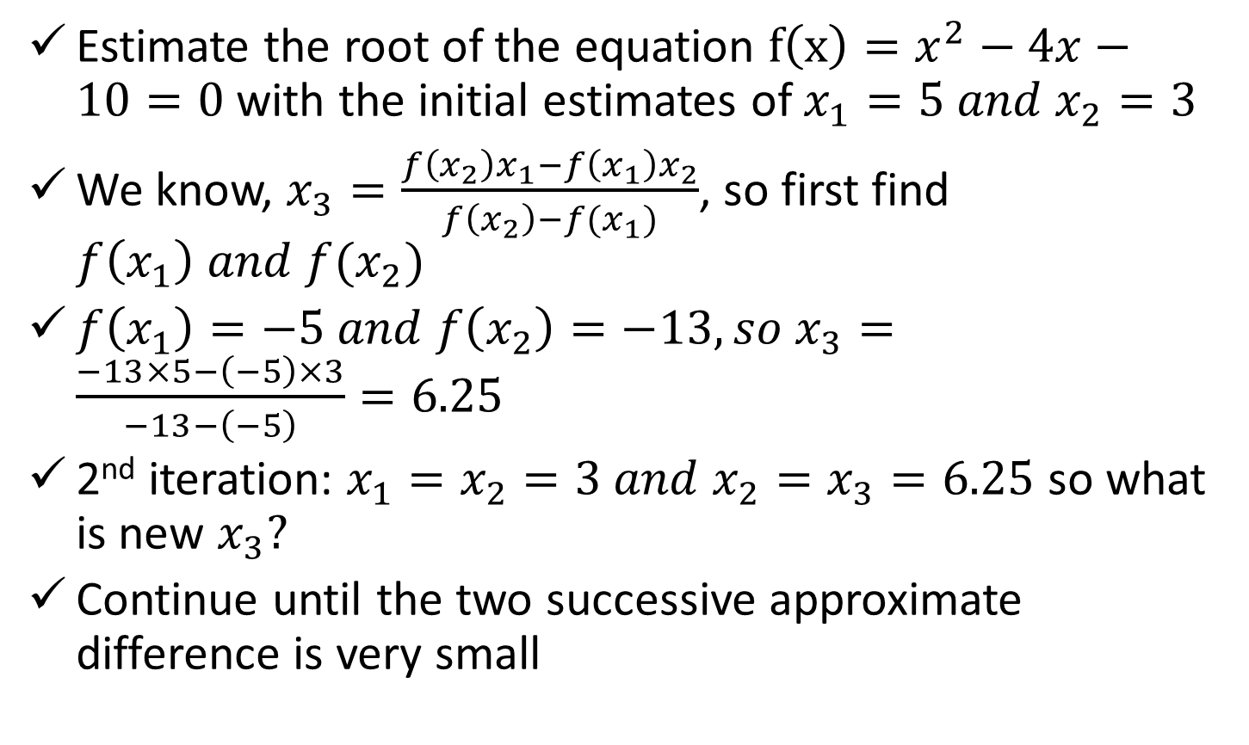
Secant Method (Cont.)
Estimate the root of the equation $f\left(x\right)=x^{2}−4x−10=0$ with the initial estimates of $x_{1}=5 and x_{2}=3$
We know, $x_{3}=\frac{f\left(x_{2}\right)x_{1}−f\left(x_{1}\right)x_{2}}{f\left(x_{2}\right)−f(x_{1})}$, so first find $f\left(x_{1}\right) and f(x_{2})$
$f\left(x_{1}\right)=−5 and f\left(x_{2}\right)=−13, so x_{3}=\frac{−13×5−\left(−5\right)×3}{−13−\left(−5\right)}=6.25$
2nd iteration: $x_{1}=x_{2}=3 and x_{2}=x_{3}=6.25$ so what is new $x_{3}?$
Continue until the two successive approximate difference is very small

Slide 3
Secant Method (Cont.)
How Secant method is different from False position method?
The initial guesses may or may not bracket the root
Has possibility of diverge, if converge, rate is higher than false position, however, False position has guaranteed convergence
Secant method is chosen over Newton-Raphson method, when?
Derivation is difficult, however secant method has slower convergence rate than Newton-Raphson method

Slide 4
References
Numerical Methods by E Balagurusamy

